Slide 1
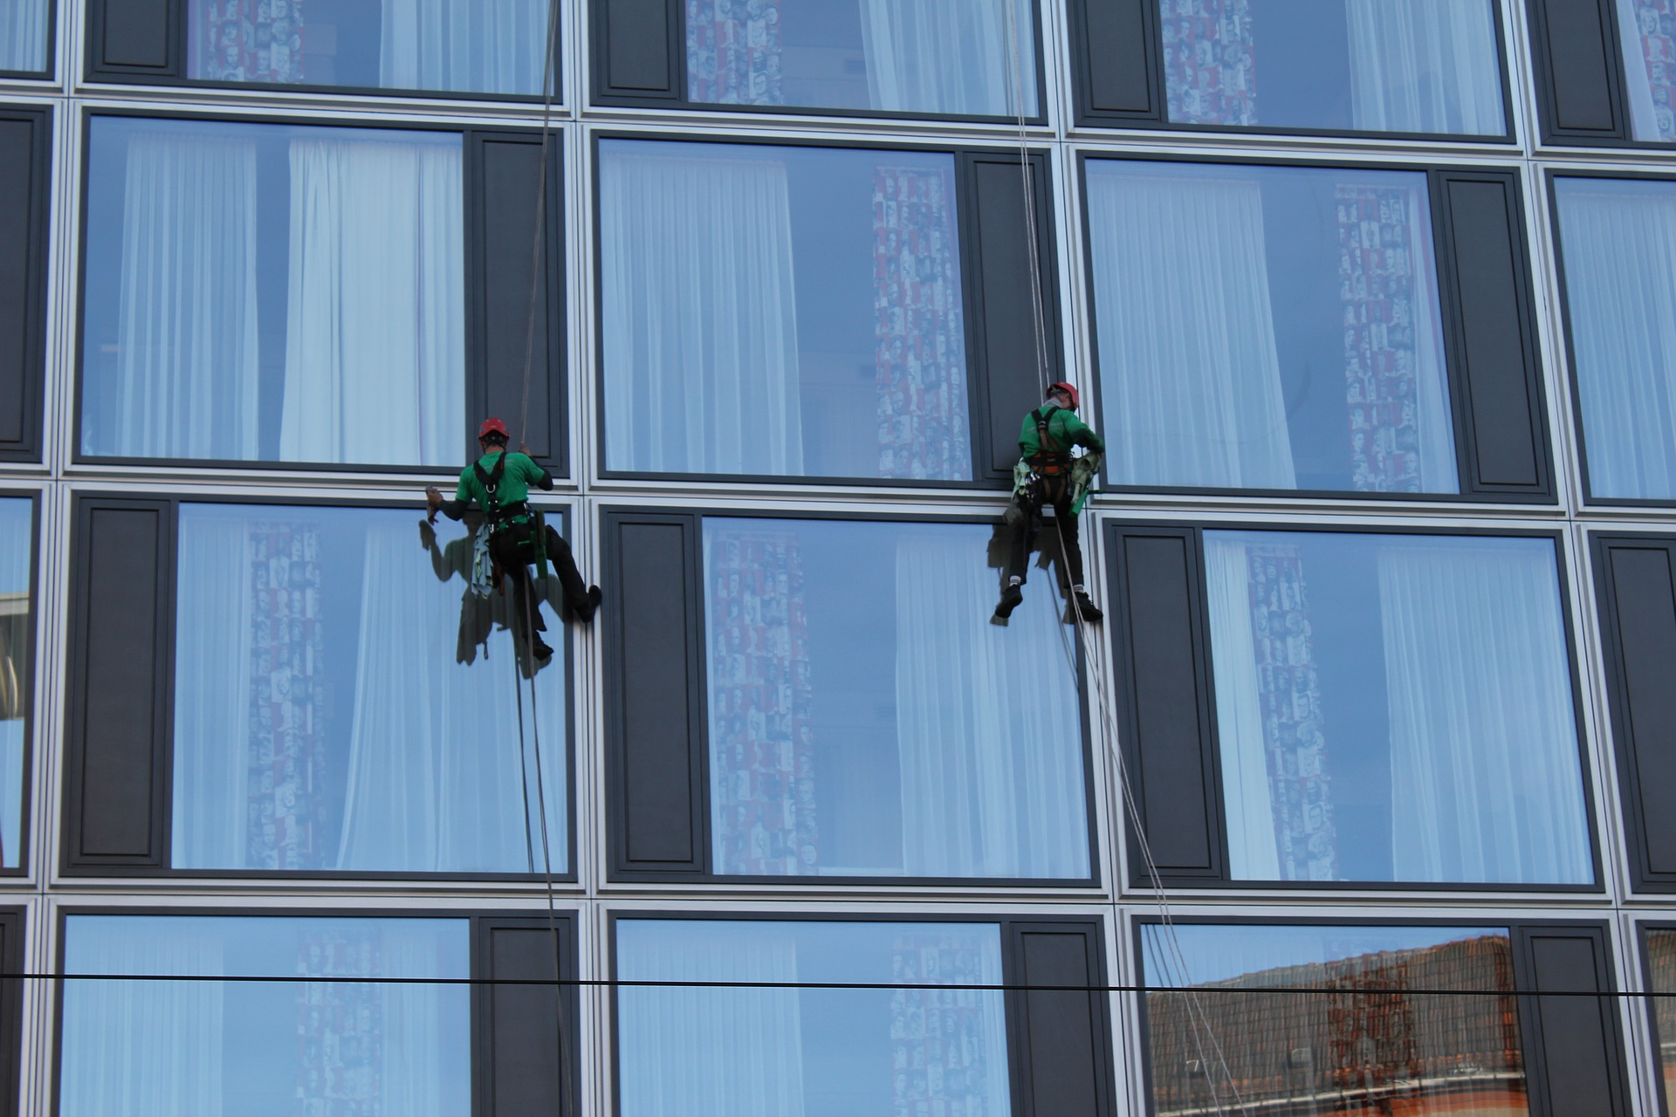
Cleaning Data
Randy Leonard
Digital frameworks
Northwestern University – Spring 2020
Github.com/randyleonard99/digitalframeworks-summer2020

Slide 2
Steps to a data story
Find data
Clean data
Analyze data
Present data

Slide 3
Agenda
Why/when we need to clean data
What to watch for
Advanced cleaning techniques using Sublime Text and OpenRefine

Slide 4
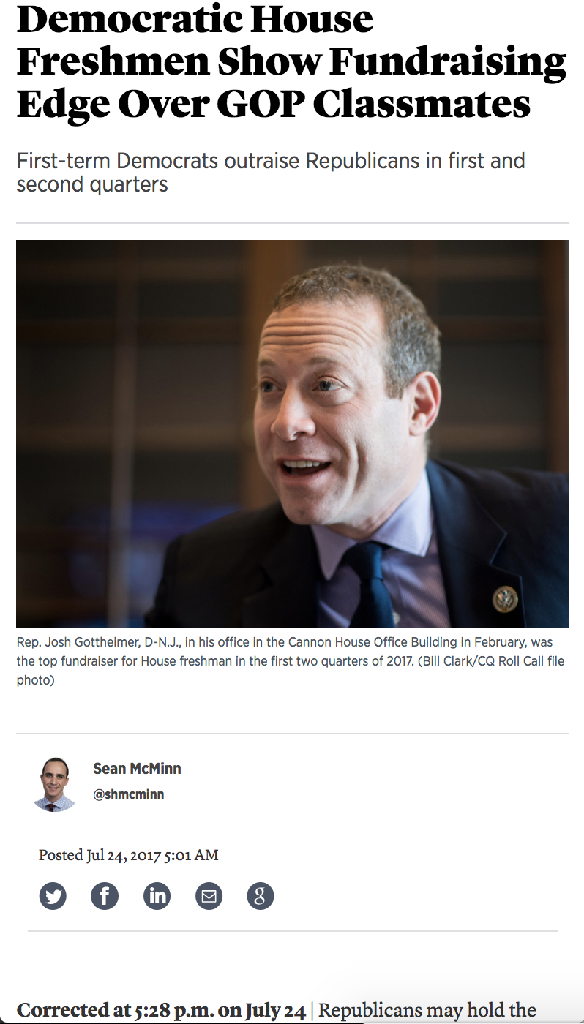
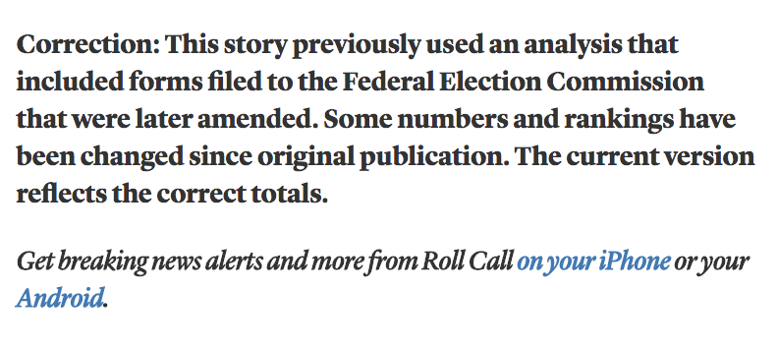
Data cleaning
Prevents this

Slide 5
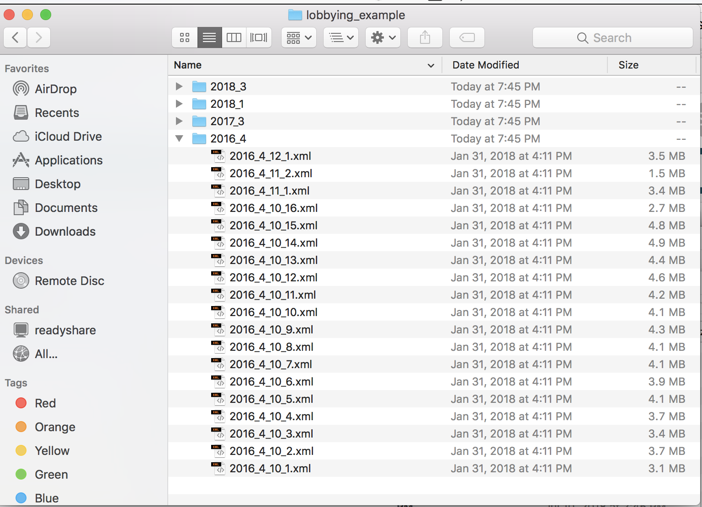
Data cleaning
And let’s you turn this

Slide 6
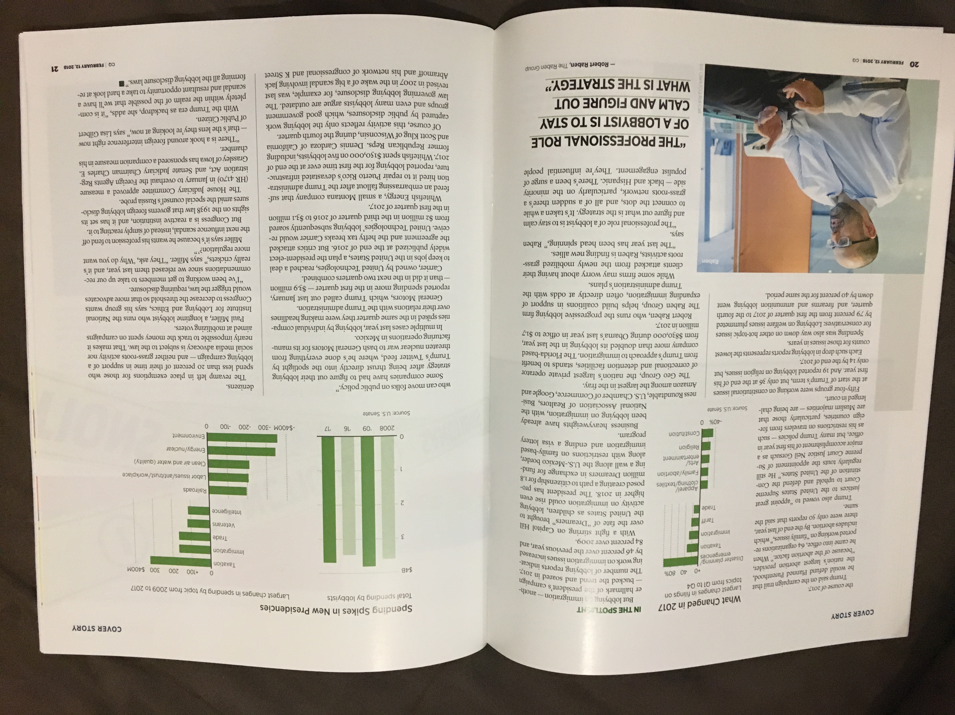
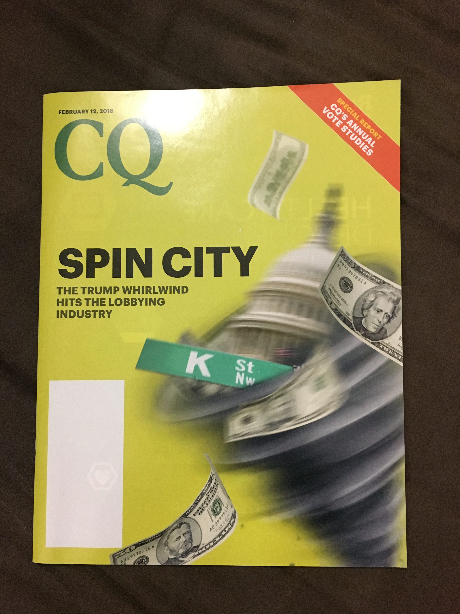
Data cleaning
Into this

Slide 7
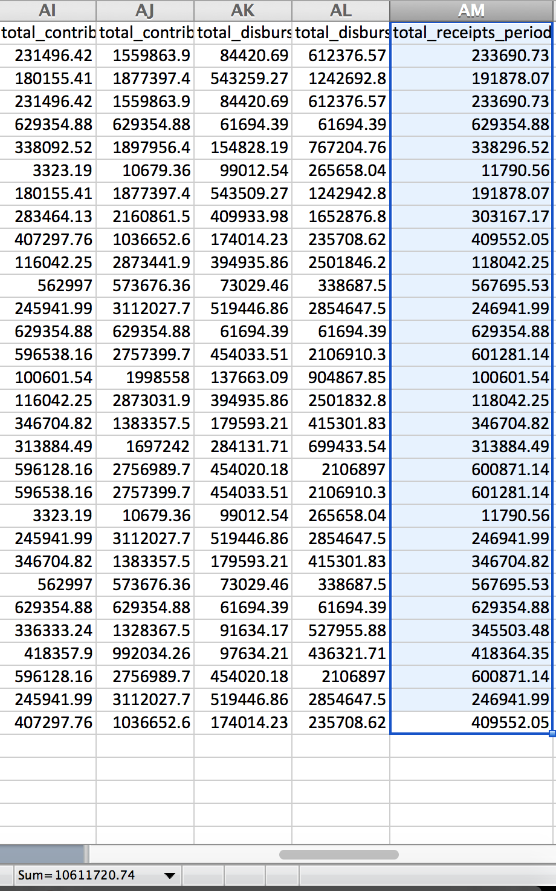
Data cleaning
How you can mess up if you don’t clean

Slide 8
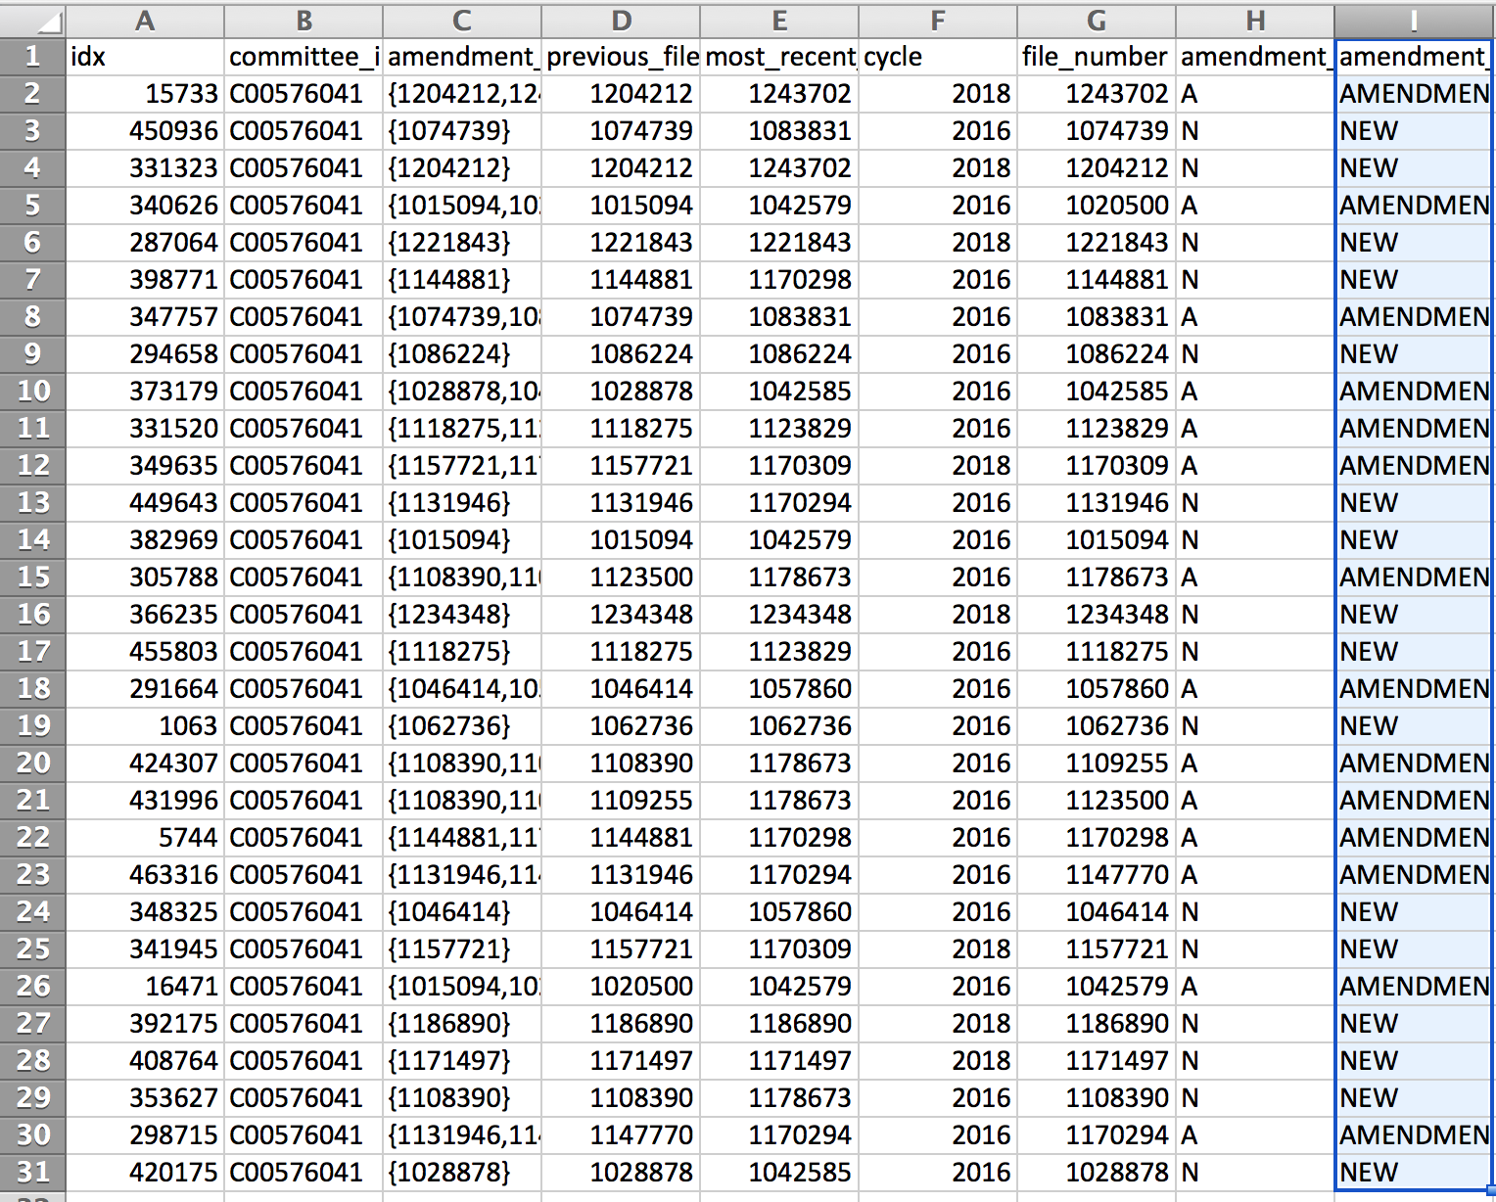
Data cleaning
How you can mess up if you don’t clean

Slide 9
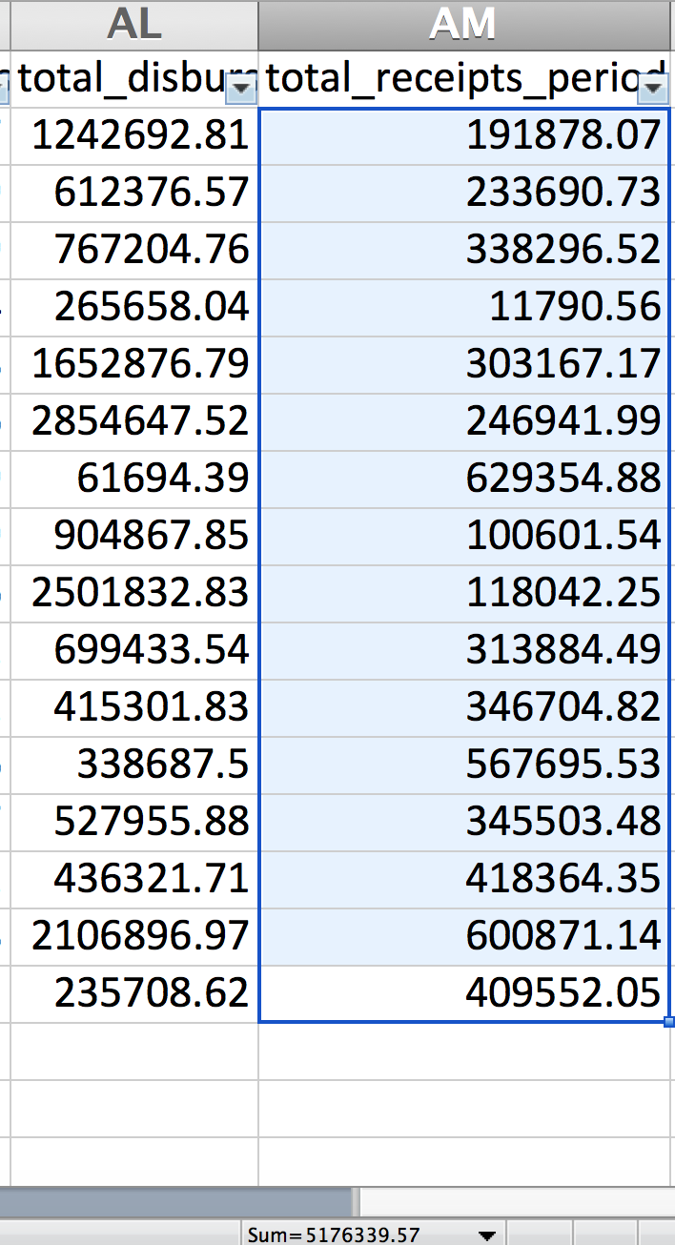
Data cleaning
How you can mess up if you don’t clean

Slide 10
Quartz’ Guide to bad data

Slide 11
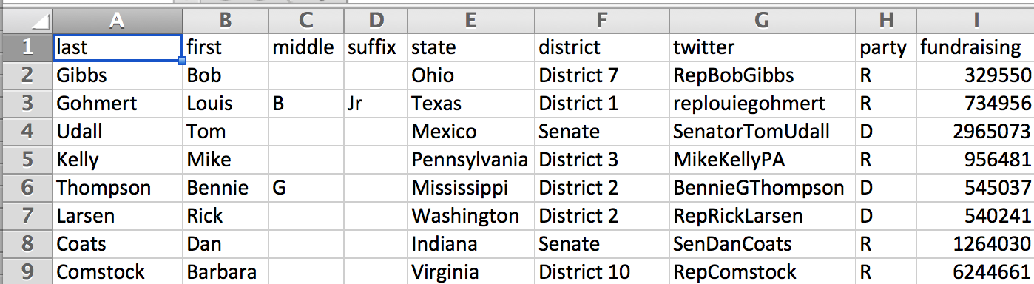
Data examples
“Good” (slash very fake) fundraising data

Slide 12
Data examples
“Good” (slash very fake) fundraising data
Separate fields in separate columns

Slide 13
Data examples
“Good” (slash very fake) fundraising data
Separate fields in separate columns
States and districts formatted the same

Slide 14
Data examples
“Good” (slash very fake) fundraising data
Clean numbers (no commas, $ signs)
Separate fields in separate columns
States and districts formatted the same

Slide 15
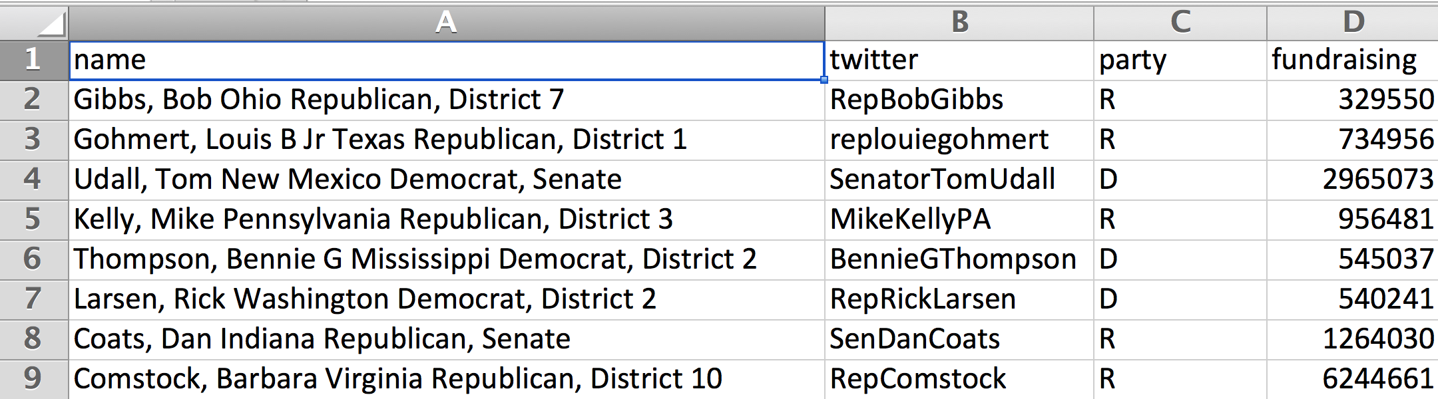
Data examples
How that data started out
Lots mashed together for each data point
Redundant column

Slide 16
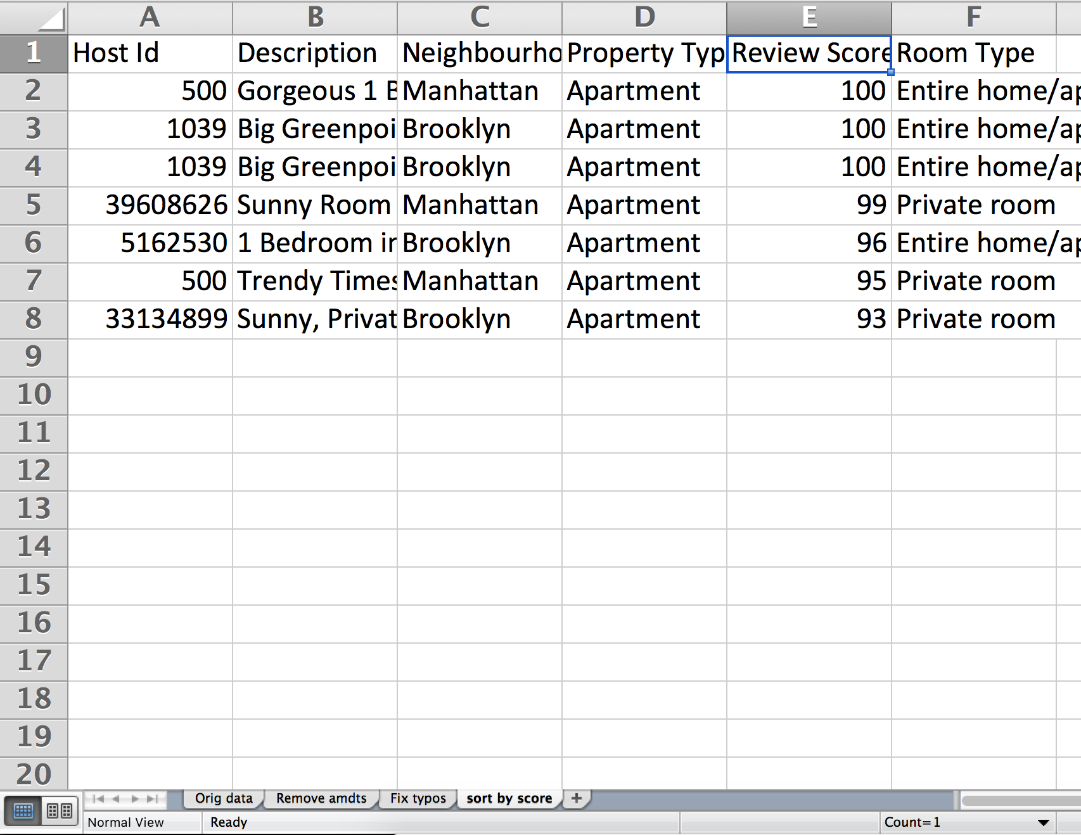
First, a word
Always work on a COPY of your data!
Always keep a RECORD of what you’re doing to your data
Example:

Slide 17

First, a word
Always work on a COPY of your data!
Always keep a RECORD of what you’re doing to your data
Example:

Slide 18
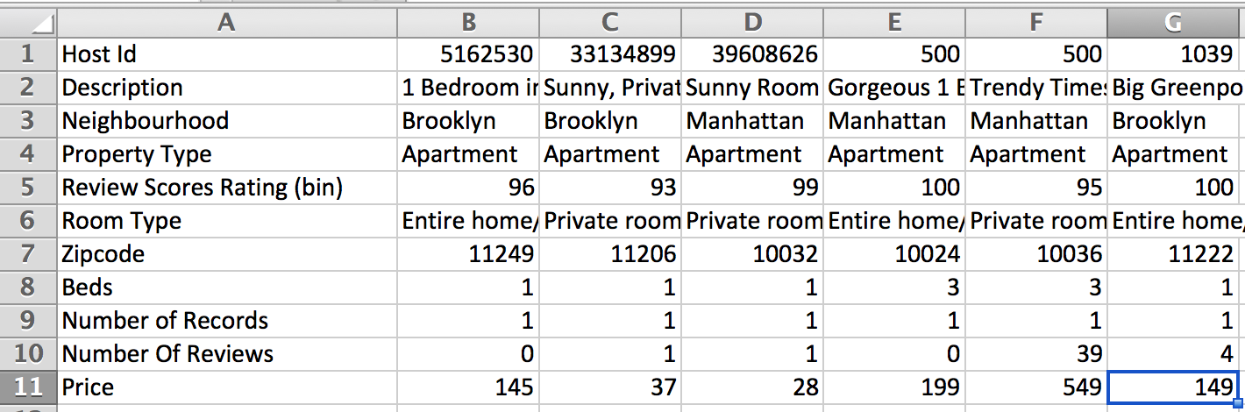
What to watch out for
Horizontal (aka “fat”) data

Slide 19
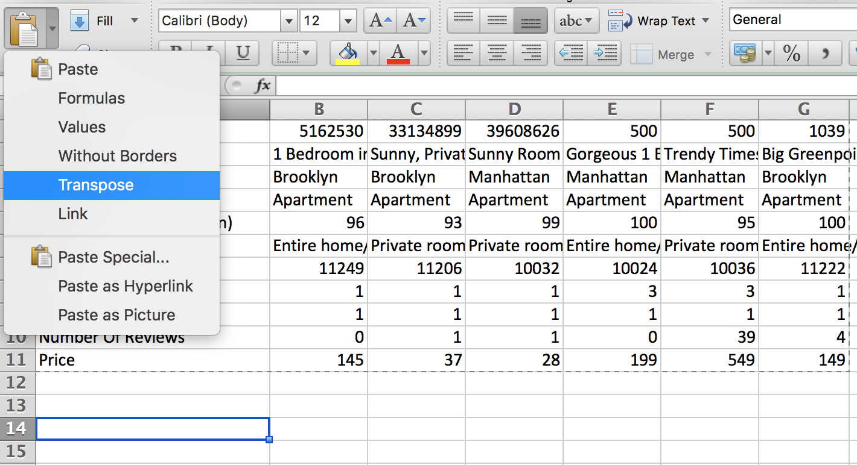
What to watch out for
Fix: Copy + Paste (transpose)

Slide 20
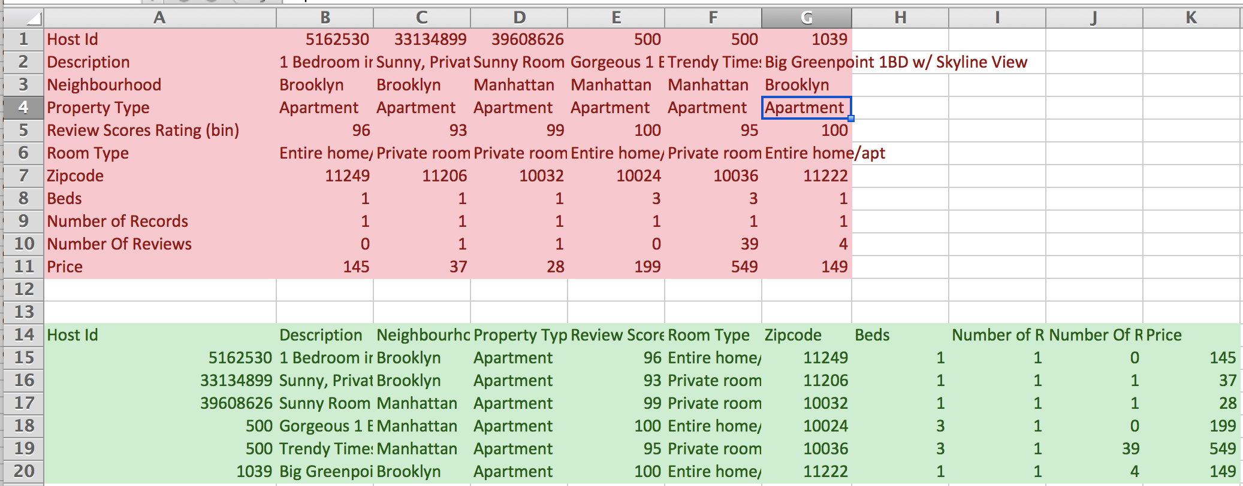
What to watch out for
Much better

Slide 21
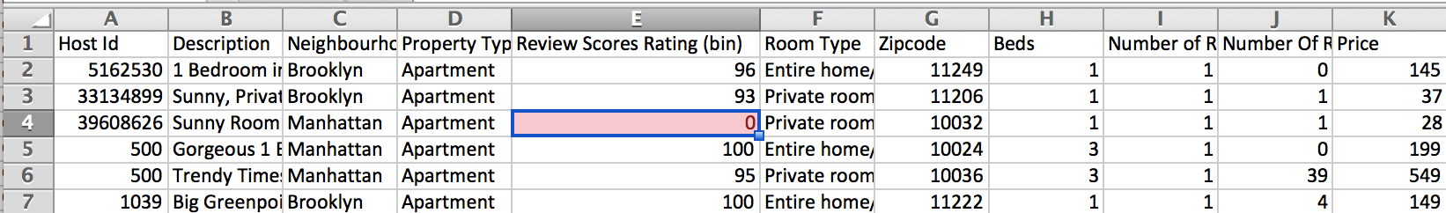
What to watch out for
Missing data
People will sometimes just BS what goes in there

Slide 22
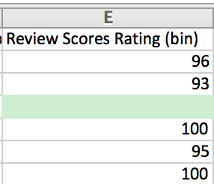
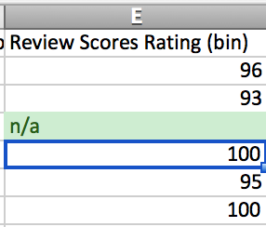
What to watch out for
Fix: Empty or put in missing indicator

Slide 23
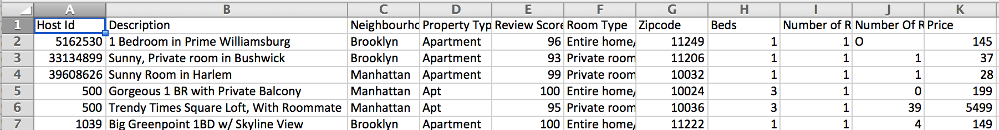
What to watch out for
Typos and/or data input inconsistency

Slide 24
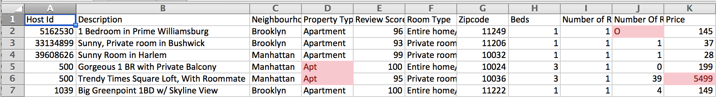
What to watch out for
Crazy outliers
Different formatting (letter O vs # 0)

Slide 25
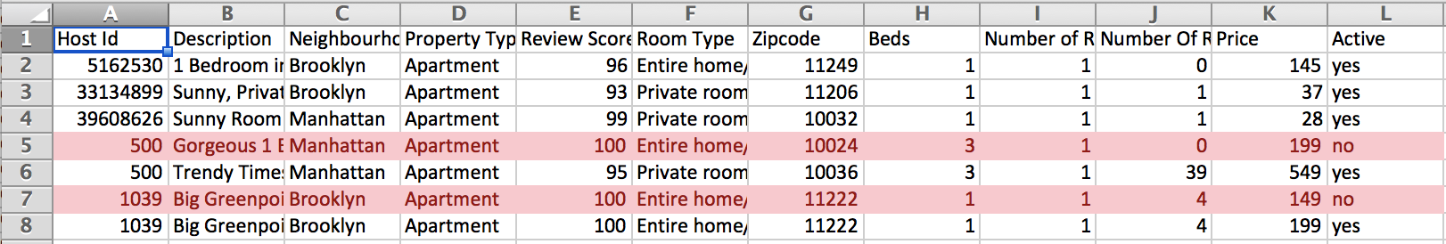
What to watch out for
Duplicates/amendments

Slide 26
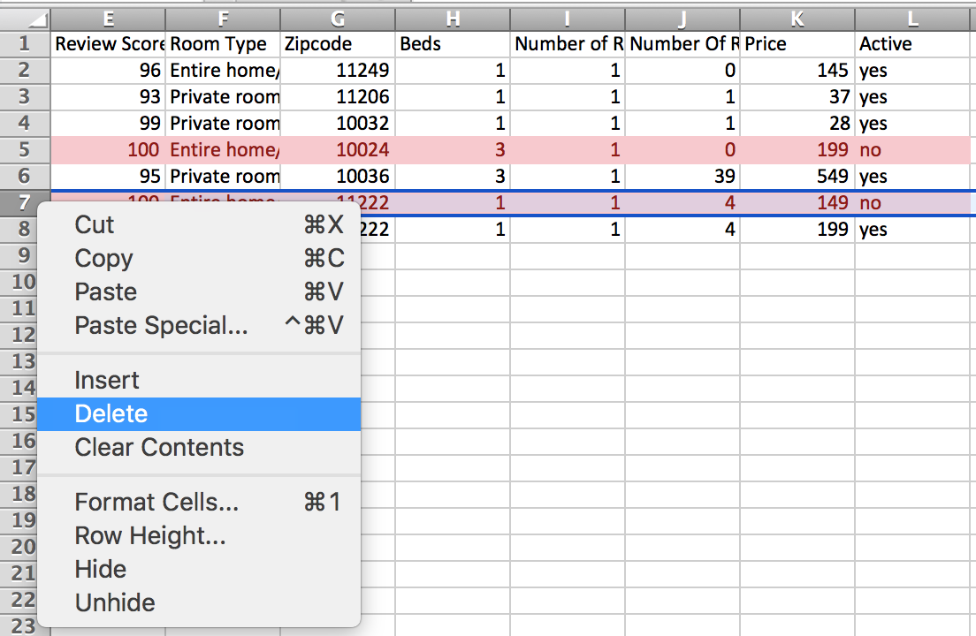
What to watch out for
Delete whole row by right clicking on row number

Slide 27
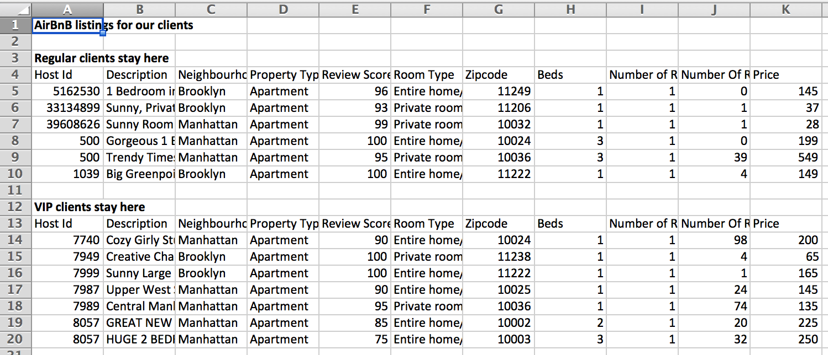
What to watch out for
Data broken into sections

Slide 28
What to watch out for
No need for title up top
Don’t want two headers
If groupings are important, add one (or more) data column(s)!

Slide 29
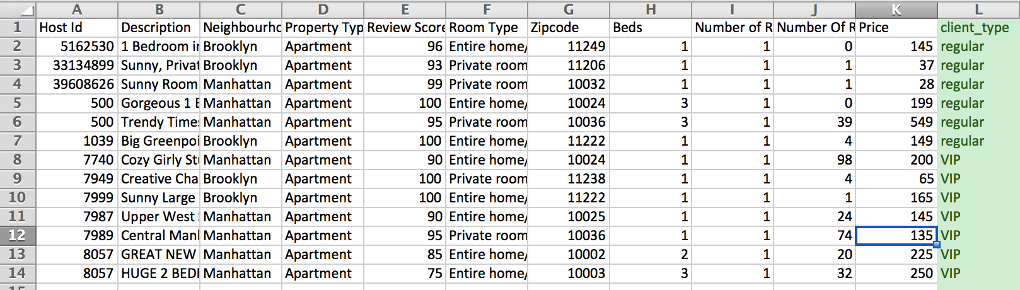
What to watch out for
Better ☺

Slide 30
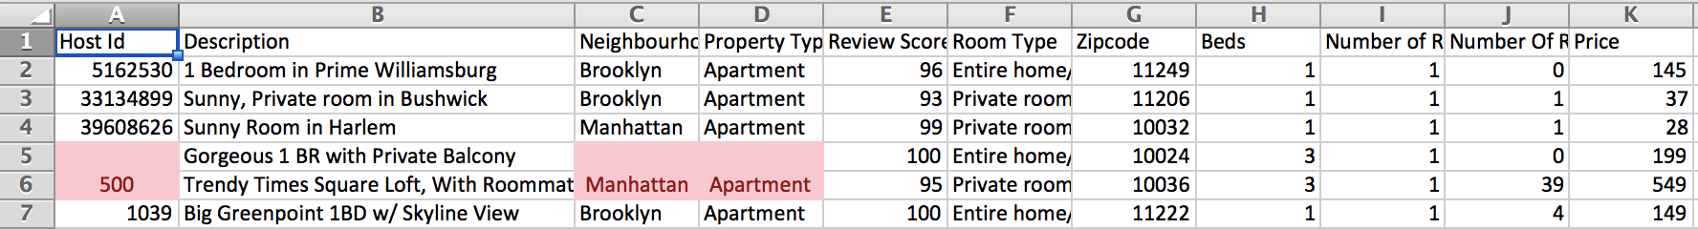
What to watch out for
Merged cells

Slide 31
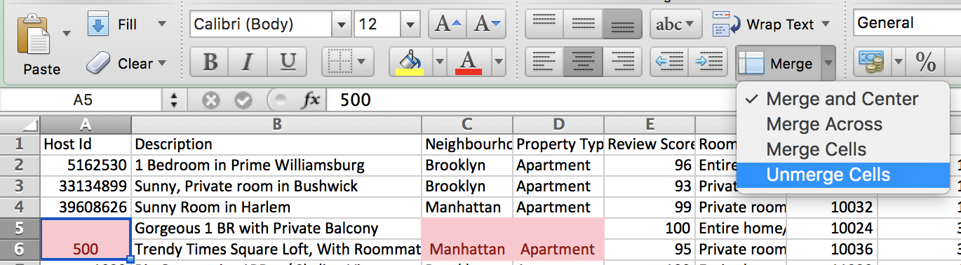
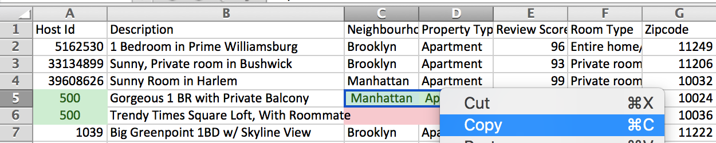
What to watch out for
Unmerge and copy the value to the blank cells

Slide 32
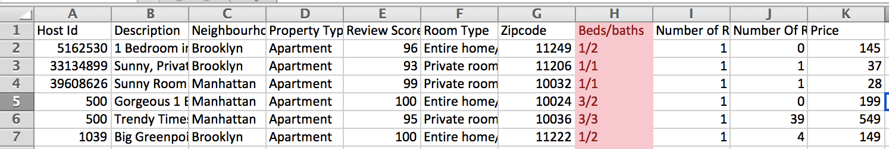
What to watch out for
Columns that should be split into two

Slide 33
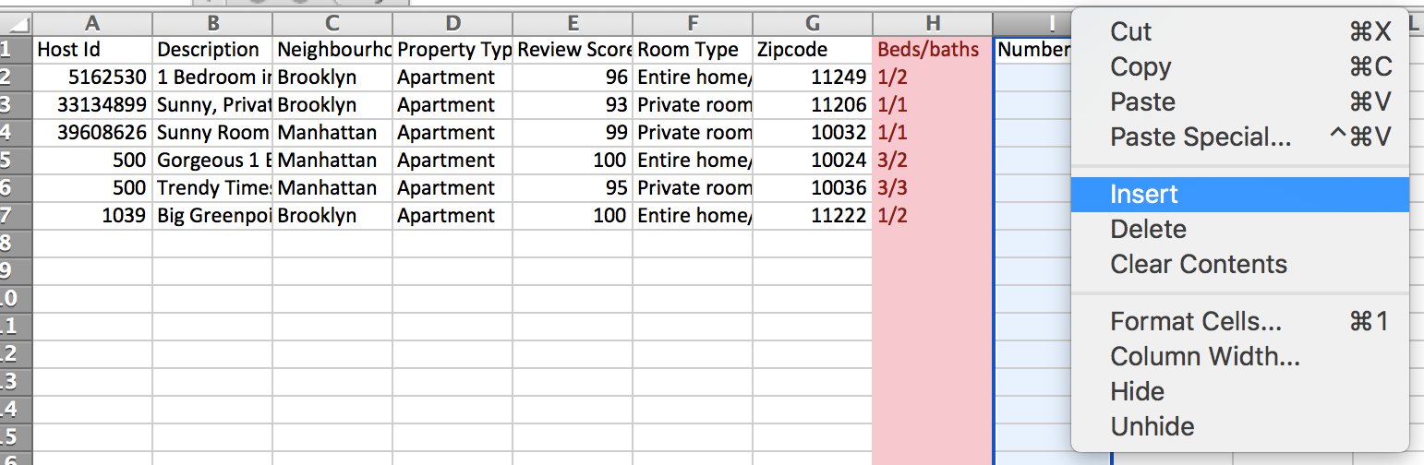
What to watch out for
Add a column next to it

Slide 34
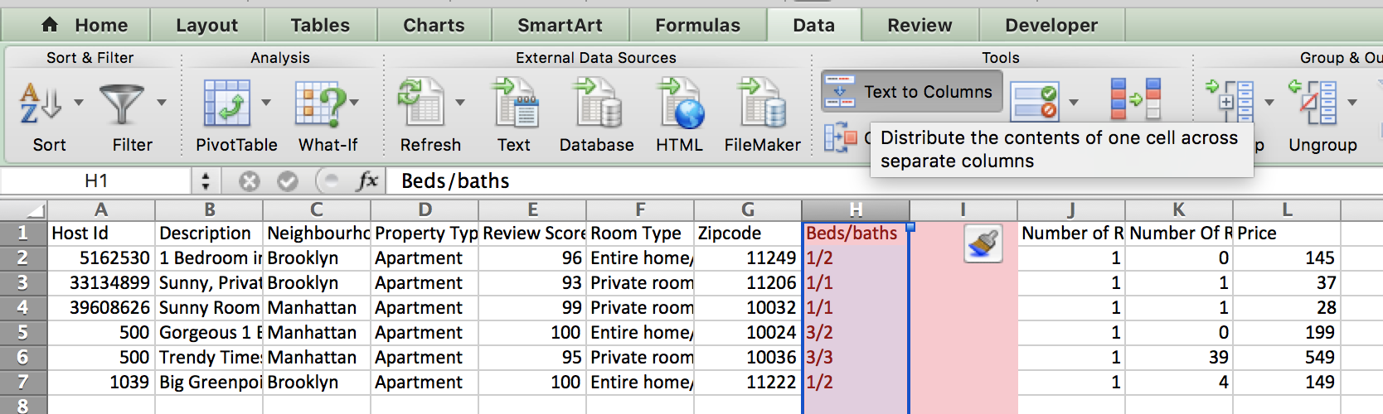
What to watch out for
Text to columns

Slide 35
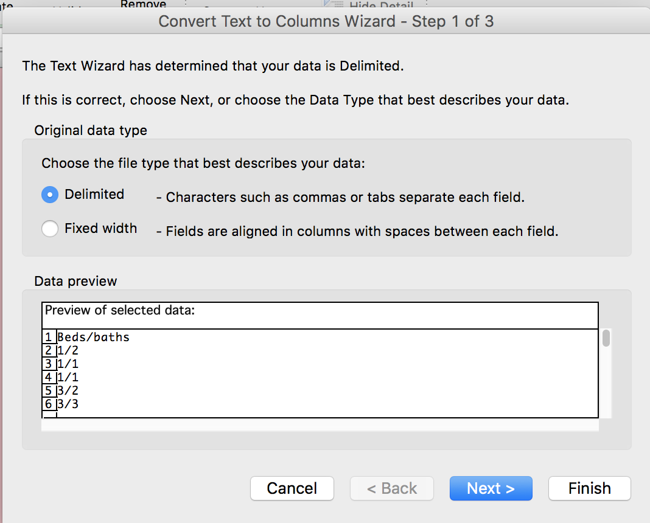
What to watch out for
Only works if data has a delimiter – something SEPARATING the data

Slide 36
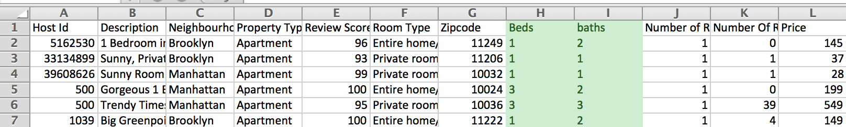
What to watch out for
Much better ☺

Slide 37
Cleaning techniques
You can do everything by hand, one at a time, but UGH

Slide 38
Cleaning techniques
Select all blanks
Salary data for Chicago:
Hours “N/A” for salaried employees
Current_Employee_Names__Salaries__and_Position_Titles.csv

Slide 39
Cleaning techniques
Filter then change
Marijuana lobbying data:
Org ➔ Organization
Marijuana-lobby-namechange.csv

Slide 40
Cleaning techniques
Find and replace
Marijuana lobbying data:
Org ➔ Organization
Marijuana-lobby-namechange.csv

Slide 41
Cleaning techniques
ADVANCED find and replace
Regular expressions, a.k.a. regex
^".*" or \n[A-Za-z]*\t or : "\d* "

Slide 42
RegEx Cheat sheet by Christian McDonald
[abc] | A single character of: a, b, or c | ^ | Start of line
[^abc] | Any single character except: a, b, or c | $ | End of line
[a-z] | Any single character in the range a-z | \A | Start of string
[a-zA-Z] | Any single char in the range a-z or A-Z | \z | End of string
(...) | Capture everything enclosed | . | Any single character
(a|b) | a or b | \s | Any whitespace character
a? | Zero or one of a (lazy) | \S | Any non-whitespace character
a* | Zero or more of a (greedy) | \d | Any digit
a+ | One or more of a | \D | Any non-digit
a{3} | Exactly 3 of a | \w | Any word character (letter, number, underscore)
a{3,} | 3 or more of a | \W | Any non-word character
a{3,6} | Between 3 and 6 of a | \b | Any word boundary

Slide 43
OpenRefine
Formerly Google Refine
Program to help find irregularities and patterns in data
Video

Slide 44
Resources
Quartz’ Guide to bad data
OpenRefine: tutorials, an advanced tutorial
RegEx (Regular expressions), tutorial , cheat sheet
Python: Advanced cleaning, Machine learning

